Slide 1
next Generation assessment INFORMATION
NIGHT
The destination school community
Memorial Junior High School
Kathybel Ortiz, M. Ed
January 22, 2015
6:30pm

Slide 2
Agenda
Next Generation Assessments
PARCC- what is it?
Relationship Between Next Generation Assessments and Common Core State Standards
PARCC Components
AIR- what is it?
What is SEL Doing To Prepare Our Students
Resources Available
Question and Answer

Slide 3
Next generation assessments
PARCC (Reading & Math)
&
AIR (Science & Social Studies)

Slide 4
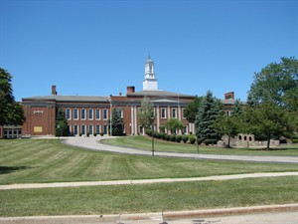
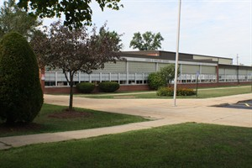
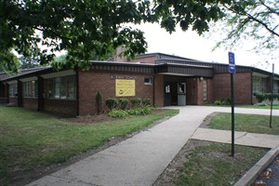
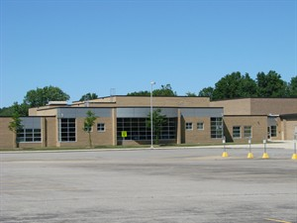
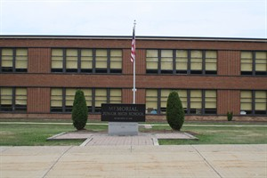
PARCC- What does it mean???

Slide 5
PARCC- What does it mean?
The Partnership for Assessments of Readiness for College and Careers (PARCC)
A group of 19 states working together to develop a common set of computer-based K-12 assessments in English Language Arts/Literacy and Math linked to the new, more rigorous Common Core State Standards (CCSS)
Common Assessments aligned with the Common Core State Standards

Slide 6
Relationship Between next generation assessments and state standards

Slide 7
Next generation assessments and common core state standards
In June 2010 Ohio adopted the CCSS, now known as Ohio’s New Learning Standards, to provide a clear, consistent expectation of what students should know in core subjects as they progress through grades K-12
PARCC and AIR assessments are directly aligned to the CCSS
Measures student progress toward these new, more rigorous standards in core subjects

Slide 8
Ohio’s new learning standards
Aligned with college and career readiness
Include rigorous content and application of knowledge through higher-order thinking skills
Provide performance-based collaborative activities and assessments
Integrate literacy across content areas, including science and social studies
Place stronger emphasis on informational text, research, and technology-media skills

Slide 9
PARCC assessment components

Slide 10
Goals of parcc consortium
Create high-quality assessments
Ensure that every child is on a path to college and career readiness
Support educators in the class with valuable data
Develop 21st century technology based assessments
Provide parents, teachers and administrators targeted student achievement data to differentiate and drive instruction
Allow for comparisons with other states and international benchmarks

Slide 11
Purpose of the PARCC
Determine whether students are college, career ready or on track
Assess the full range of the Common Core State Standards, including standards that are difficult to measure (ex. speaking, listening, synthesizing and applying text and multi media)
Utilize innovative approaches to measure student growth over time

Slide 12
Components of the new generation assessments
Performance Based Assessments (PBA)
End of Year Assessments (EOY)
Both Include the following
Constructed Response
Extended Performance tasks
Evidence-Based Selected Response (EBSR)

Slide 13
Performance based assessment (PBA)
Testing schedule
Administered 75% through the school year
Flexible Testing Window: February 17- March 6
Math 1 (February 17); Math 2 (February 19); ELA 1 (February 24); ELA 2 (February 26);
ELA 3 (March 3)
8th grade Science (March 5)

Slide 14
Performance based assessment (PBA)
Content
ELA/Literacy PBA will focus on writing effectively while analyzing related texts. Tasks: Literacy Analysis, Research Simulation, and Narrative Writing
Math PBA will focus on applying skills, concepts, and understanding to solve multi-step problems requiring abstract reasoning, precision, perseverance, and strategic use of tools.

Slide 15
End of year assessment (EOY)
testing schedule
Administered 90 % through the school year
Flexible Testing Window–April 13- May 15
Math 1 (April 14); Math 2 (April 16); ELA 1 (April 21); ELA 2 (April 23);
8th grade Science (May 5)

Slide 16
End of year assessment (EOY) content
Overall focus on innovative, short answer questions and items to measure concepts and skills
ELA/Literacy EOY will focus on demonstrating comprehension of literary and informational texts and definition of words based on reading of texts rather than memorization
Math EOY will focus on demonstrating understanding of mathematical concepts , procedures and short applications

Slide 17
Performance based assessment Time on task (PARCC): Grade 7-8
ELA/Literacy
Session 1 Session 2 Session 3
Testing Time 75 min 90 min 60 Min
Total Time 225 minutes
Math Session 1 Session 2
Testing Time 80 min 70 min
Total Time 150 minutes

Slide 18
End of year assessment Time on task (PARCC): Grade 7-8
ELA/Literacy
Session 1 Session 2
Testing Time 60 min 60 min
Total Time 120 minutes
Math Session 1 Session 2
Testing Time 80 min 75 min
Total Time 155 minutes

Slide 19
Let’s take a look at parcc samples for grades 7-8

Slide 20
E/la Grade 7 (PARCC) sample item
CLAIMS
Earhart and Noonan lived as castaways on Nikumaroro Island.
Earhart and Noonan’s plane crashed into the Pacific Ocean
People don’t really know where Earhart and Noonan died.
Part A: Highlight the claim that is supported by the most relevant and sufficient facts within “Earhart’s Final Resting Place Believed Found.”
Part B: Select two facts within the article that best provide evidence to support the claim selected in Part A.

Slide 21
Math Grade 8 (PARCC) sample item

Slide 22
PARCC Calculator policy
Grades 6-7-Will allow a four function calculator with square root
Grade 8- Will allow for a scientific calculator
District provided

Slide 23
Old assessment vs new assessment
parcc Writing prompt
Writing prompt on oaa
Read the writing prompt below and complete writing activity
Jump out of bed! Look at weather. Perfect weather.
Write a story about a day when the weather seemed perfect.
You have read two texts about famous people in American history who solved a problem by working to make a change.
Write an article for your school newspaper describing how Eliza and Carver faced challenges to change something in America.
In your article, be sure to describe in detail why some solutions they tried worked and others did not.
Tell how the challenges each one faced were the same and how they were different.

Slide 24
AIR- What does it mean???

Slide 25
air
American Institute for Research
Ohio will administer Science and Social Studies assessments using the AIR testing delivery system

Slide 26
Performance based assessment Time on task (AIR): Grade 8
Science
Testing Time 75 minutes

Slide 27
End of year assessment (EOY) Time on task (AIR): Grade 8
Science
Testing Time 75 minutes

Slide 28
Let’s take a look at an AIR Science sample for grades 8

Slide 29
Science Grade 8 (AIR) sample item
A scientist is studying a chemical reaction. She predicts that after the reaction
the products will have less chemical potential energy than the reactants
had originally.
The scientist observes the reaction, and notes that no light or sound is
produced. However, other observations support the scientist’s prediction that
the total chemical potential energy has decreased.
Describe one observation that would support her prediction.
Write your answer in the Answer Document.

Slide 30
What is sel doing to support our students

Slide 31
How are we preparing for PARCC
Full implementation of Ohio’s New Learning Standards
Math and Literacy programs are aligned to the CCSS
Assessment questions are aligned to New Generation Assessments
Focus on informational text (non fiction), citing evidence, and critical analysis
Focus on fact fluency and problem solving
Use of internet resources including PARCC website
Ongoing professional development for teachers and administrators

Slide 32
Now vs. the future
2014-2015 school year PARCC and AIR will be done with paper and pencil
2015-2016 school year PARCC and AIR will be computer-based

Slide 33
How can you help prepare your child
Expose to literature and support them in making connections
Practice automaticity of math facts!!
Encourage multi-step mathematical problem solving
Have them justify their answers
Practice typing as much as possible (see SEL website -student links)
Utilize the PARCC Sample Questions & Practice Tests
Utilize the resources on the SEL, ODE, PARCC , NWOCA and National PTA websites
Daily sustained reading

Slide 34
Parent resources
www.parcconline.org
http://nextgen.nwoca.org
www.sel.k12.oh.us
http://education.ohio.gov/
Common Core Resources
http://www.pta.org/commoncore

Slide 35
Q/A

